Slide 1


Job
Interviews
English Department
April
2020

Slide 2

Have you been in a job interview before or similar?
Do you think is a good idea to be prepared to get a job interview?
Before Watching
Search for these new words and expressions…
Gather - hunter – What do you do? – skills – C.V. - chief

Slide 3



Slide 4

How much can you remember about the video?
Let’s see…

Slide 5
Quiz
What does the interviewed do?
What do men need these days?
How long did the man live with the other tribe?
Why did the man leave the tribe?
Finally, did the man obtain the job? Why?
5

Slide 6

Suffixes and Job
Suffixes are a group of letters added to the end of the word to change its part of speech or its meaning. Example:
SUFFIXES | BASE WORD | JOB
-ant | Assist | assistant
 | Account | accountant
-or | Act | actor
 | Operate | operator
-er | Dance | dancer
 | Play | player
6

Slide 7
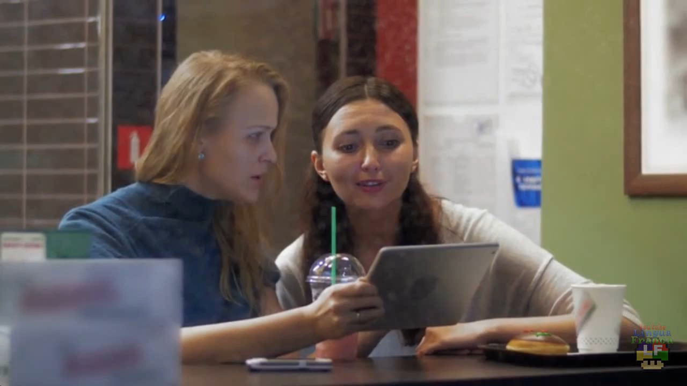

Slide 8


Quiz
Complete the following worksheet using suffixes.
8

Slide 9
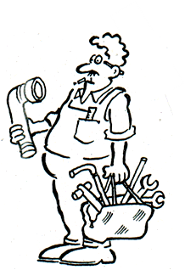
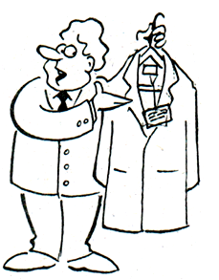
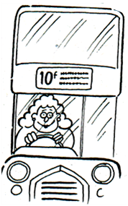
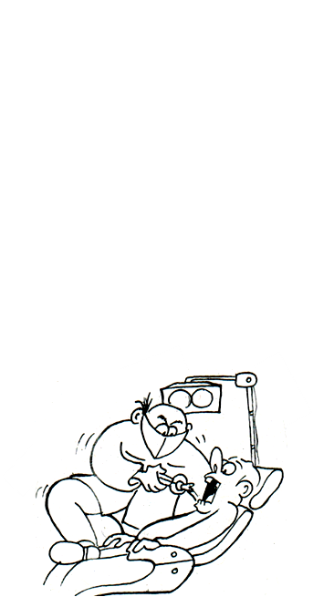
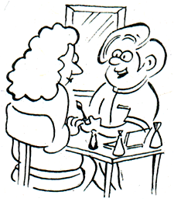
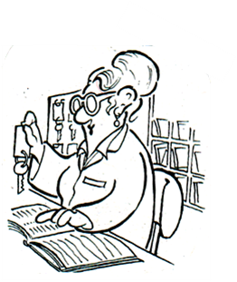
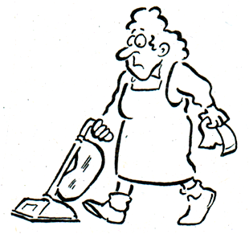
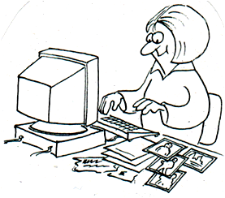
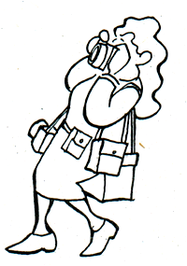
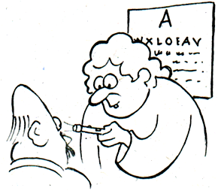
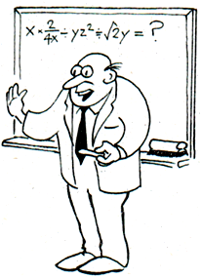
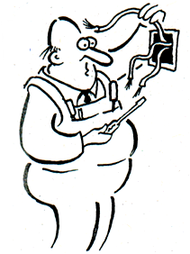
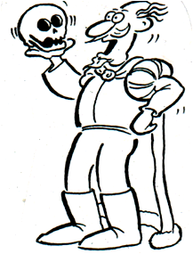
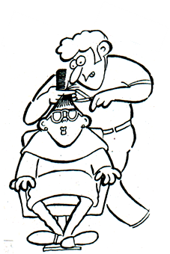
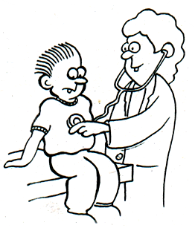
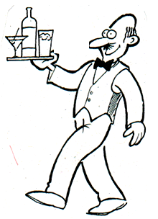
Jobs
Choose the correct ending for the jobs: -er, -or, -ant,
-ian, or -ist. Then match the pictures to the jobs.
3.
4.
act_____
dent_____
doct_____
driv_____
hairdress_____
journal_____
reception_____
wait_____
beautic_____
clean_____
electric_____
optic_____
photograph_____
plumb_____
sales assist_____
teach_____
1.
2.
5.
6.
12.
10.
13.
9.
11.
7.
16.
8.
15.
14.

Slide 10



THANK YOU
Miss. Francisca Ipinza III°C
Miss. Daniela Moreno III°A y III°B
francisca.ipinza@elar.cl
daniela.moreno@elar.cl

